Slide 1

Cryptography
Martzel P. Baste

Slide 2

Cryptography
the science of using mathematics to encrypt and decrypt data.
it enables you to store sensitive information or transmit it across unsecured networks (like the Internet) so that it cannot be read by anyone except the intended recipient.
”kryptos" means "hidden” "graphy" stands for "writing."
Notes:
The word "cryptography" is derived from the Greek kryptos, meaning hidden.
The prefix "crypt-" means "hidden" or "vault," and the suffix "-graphy" stands for "writing."

Slide 3
Cryptography
The art of secret writing
The art of protection using information
The science of encrypting or hiding secrets
Needed for confidentiality

Slide 4
Objectives
Confidentiality
Integrity
Non-repudiation
Authentication

Slide 5

plaintext
ciphertext
cipher
key
encipher (encrypt)
decipher (decrypt)
cryptography
cryptanalysis (codebreaking)
cryptology
the original message
the coded message
algorithm for transforming plaintext to ciphertext
info used in cipher known only to sender/receiver
converting plaintext to ciphertext
recovering ciphertext from plaintext
study of encryption principles/methods
the study of principles/ methods of deciphering ciphertext without knowing key
the field of both cryptography and cryptanalysis

Slide 6
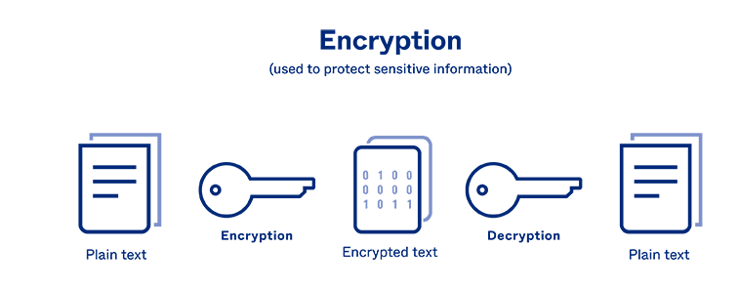
Conventional Encryption

Slide 7
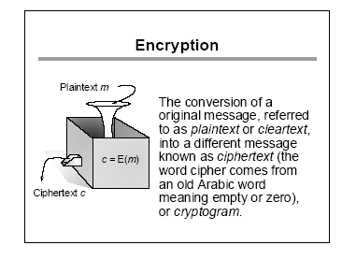
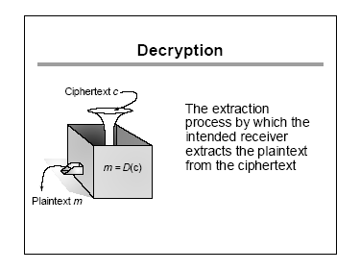

Slide 8
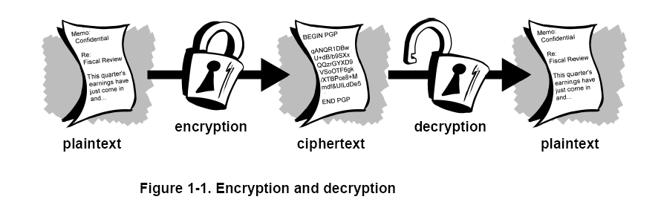

Slide 9
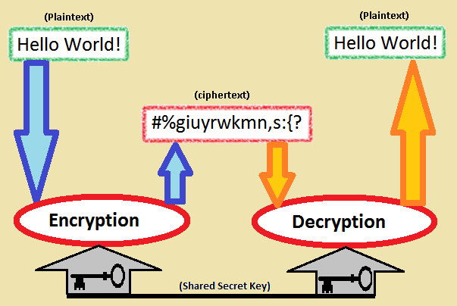

Slide 10
CRYPTOLOGY
CRYPTOGRAPHY
Private Key
(Secret Key)
Block Cipher
Stream Cipher
Public Key
Integer Factorization
Discrete Logarithm
CRYPTANALYSIS

Slide 11
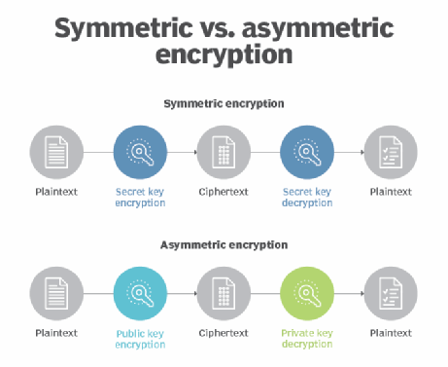

Slide 12
Classical Cryptography
Monoalphabetic Ciphers
Polyalphabetic Ciphers
Shift Cipher (Caesar Cipher)
Substitution Cipher
Affine Cipher
Vigenère Cipher
Hill Cipher
Permutation Cipher

Slide 13
Benefits of Cryptography
Offers individual privacy and confidentiality.
In some circumstances also authentication and non-repudiation (e.g. legal ‘signatures’)
Especially important in explicitly Authorization .

Slide 15
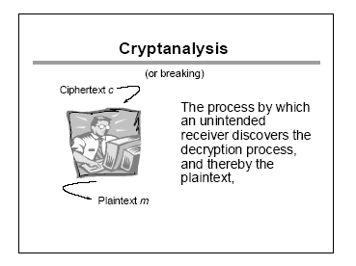

Slide 16
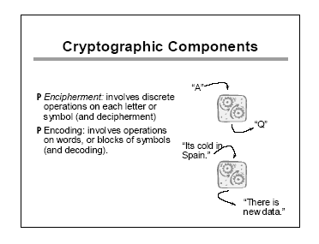

Slide 17
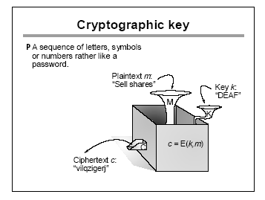

Slide 18
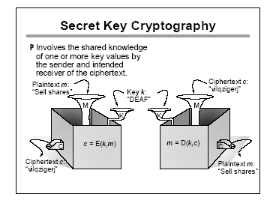

Slide 19
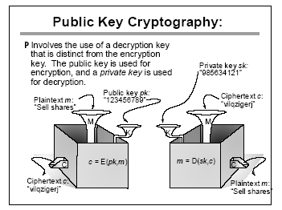

Slide 20
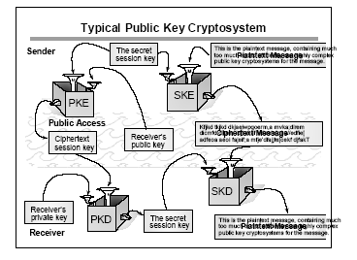

Slide 21
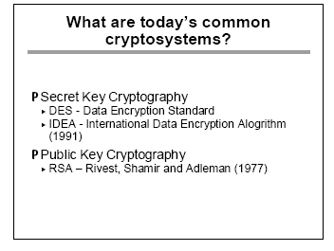

Slide 22
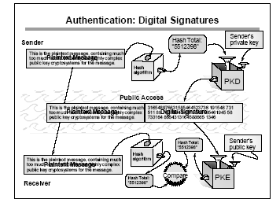

Slide 23
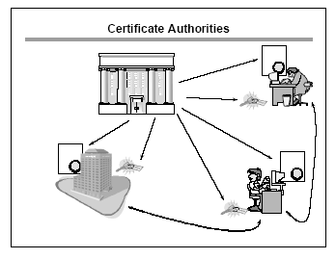

Slide 24
